Slide 1


Slide 2

Ways of communication

Slide 3

Unit 10: COMMUNICATION
Lesson 2 – A closer look 1

Slide 4
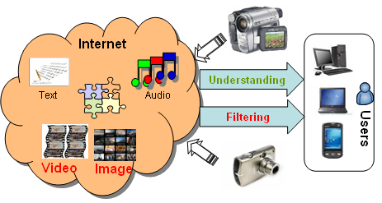

Slide 5
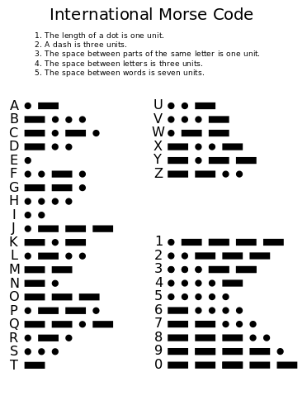

Slide 6
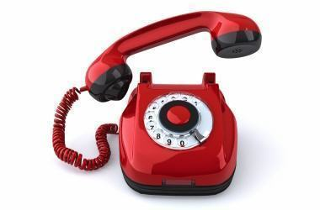

Slide 7
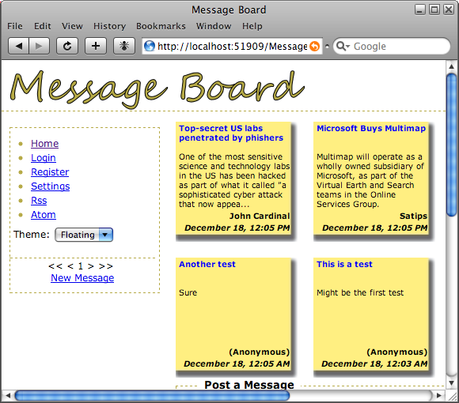

Slide 8
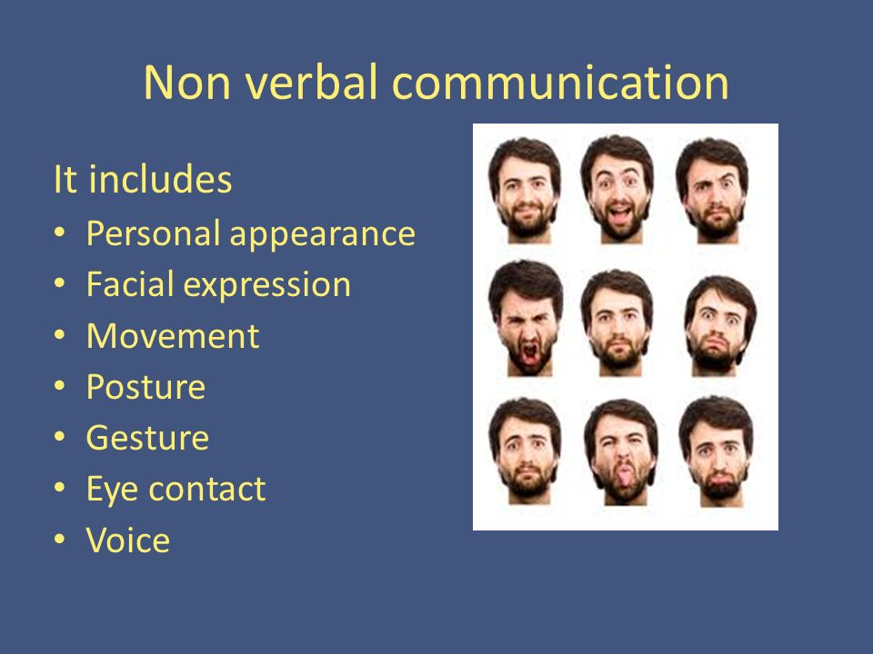

Slide 9
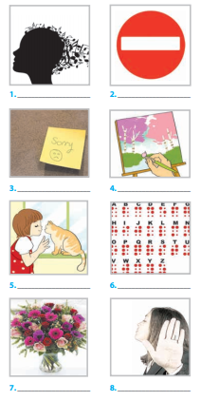
Other ways of communication
a. ____ communicating
non-verbally with animals
5
b. ____ leaving a note
3
1.
2.
c. ____ using codes
6
d. ____ using signs
2
3.
4.
e. ____ using body language
8
f. ____ sending flowers
7
5.
6.
g. ____ painting a picture
4
h. ____ using music
1
7.
8.

Slide 10
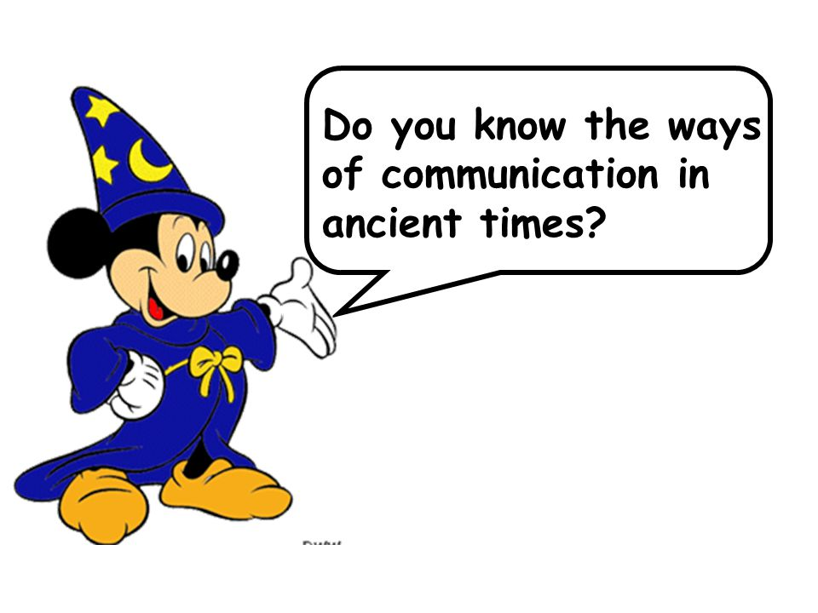

Slide 11
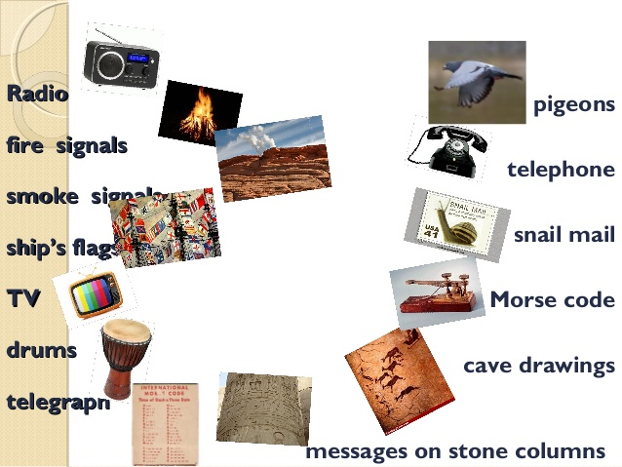

Slide 12
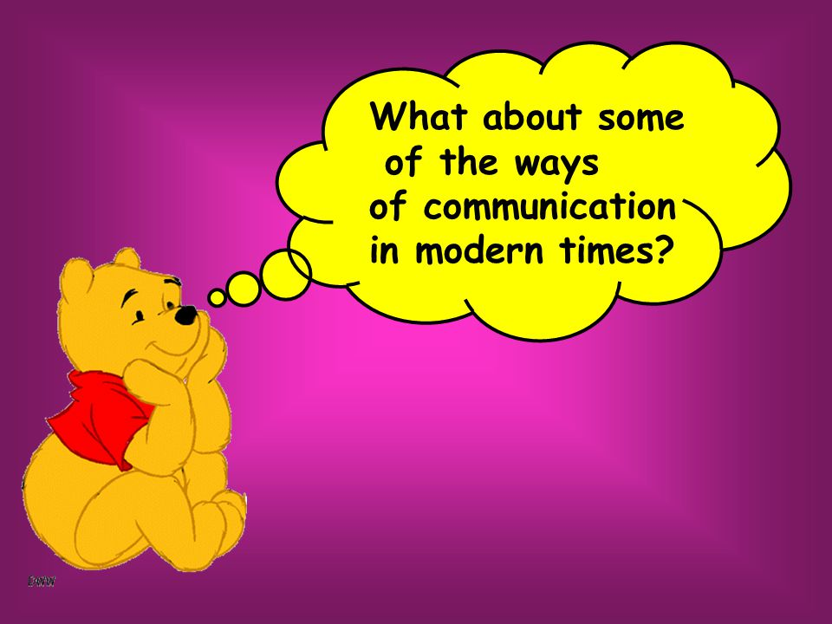

Slide 13



Slide 14
2. Communication technology. Match the words with the definitions.
1. Chat room | a. An online discussion group in which you can leave messages or post questions.
2. Multimedia | b. A phone that uses a telephone line for transmission.
3. Landline phone | c. A device with a touchscreen with functions similar to a computer, a digital camera and a GPS device in addition to a phone.
4. Smart phone | d. People join this Internet area to communicate online .The conversations are sent immediately and are visible to every one there.
5. Message board | e. Multiple forms of communication on a computer including sounds ,videos ,video-conferencing , graphics and texts.

Slide 15
3. Complete the diagram with the communication examples you have learnt so far. Some can be put in more than one category. Can you add more ideas?
- meeting F2F
Verbal
- video conference
- discussion group ...
- using body language
Forms of communication
Non-verbal
- using codes
- using signs
- sending flowers
- painting a picture…
Multimedia
- email
- snail mail
- texting…

Slide 16
4. Debate. Choose one or more pairs of ways of communicating. Which one is better? Why?
Email
Snail mail
VS
Video conference
F2F meeting
VS
Mobile phone
Landline phone
VS
Message board
F2F discussion group
VS

Slide 17
PRONUNCIATION
*Stress in words ending in -ity and -itive
For words ending –ity and –itive, place the stress on the syllable before the suffix
      sensitive
      necessity
      opportunity
positive
‘
‘
‘
‘

Slide 18

5. Mark the stress for the following words then listen and repeat.
‘
‘
1. competitive 5. ability
2. infinitive 6. possibility
3. repetitive 7. curiosity
4. positive 8. nationality
‘
‘
‘
‘
‘
‘

Slide 19
6. Fill the gaps with the words in 5 and practise saying the sentences .Then listen and check.
nationality
1.What’s his …….............?- He’s Japanese.
2. Try not to use this word too often otherwise your text will become …………...
3. Sport can be either ………...........or non-competitive.
4.There’s a good …………….that they will win.
5. Her dancing ………...is impressive!
repetitive
competitive
possibility
ability

Slide 20


Thank you for your attendance
Goodbye!

Slide 21

Unit 10: COMMUNICATION
Lesson 2 – A closer look 1

Slide 22
3. Complete the diagram with the communication examples you have learnt so far. Some can be put in more than one category.
Can you add more ideas?
Verbal
Forms of communication
Non-verbal
Multimedia

